Slide 1
The Perceptron
Perceptron?
Formulas of Perceptron
Activation Function
Multi-layer Perceptron

Slide 2
The Perceptron
Perceptron was introduced by Frank Rosenblatt in 1957
The basic building block (or) unit of the neural network.
The perceptron is a network (neural network) at takes a number of inputs carry out some processing on those inputs and produces an output.
It is also called an Artificial Neuron. It consists of a single neuron with a number of adjustable weights.
Initially the perceptron was designed to take a number of binary inputs, and produce one binary output.

Slide 3
The Perceptron
Nodes
Synapse
Axon
X₁
W₁
X₂
Neuron
W₂
Dendrites
Y
W₃
X₃
W₄
X₄
Output Layer
Input Layer
It is based on a slightly different artificial neuron called a linear threshold unit (LTU).
W₁

Slide 4
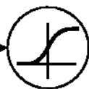
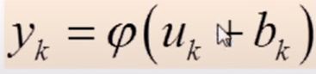

Nodes
Synapse
Bias (B_{k})
W₀ =1
Axon
X₁
W₁
X₂
Activation Function
W₂
∑
Dendrites
Y
X₃
W₃
W₄
Summing Junction
X₄
Output Layer
Input Layer
X- Input
Y- Output
Y=X₁ + X₂ + X₃ + X₄
Y=W₁X₁+W₂ X₂ + W₃X₃ +W₄ X₄ + B_{k}
In mathematical terms, a Neuron k can be described as:
U_{k}= $\sum_{i=0}^{n}{WiXi}$
The output :

Slide 5
Activation functions in Neural Networks
Activation function decides, whether a neuron should be activated or not by calculating the weighted sum and further adding bias with it. The purpose of the activation function is to introduce non-linearity into the output of a neuron.
A neural network without an activation function is essentially just a linear regression model. The activation function does the non-linear transformation to the input making it capable to learn and perform more complex tasks.

Slide 6
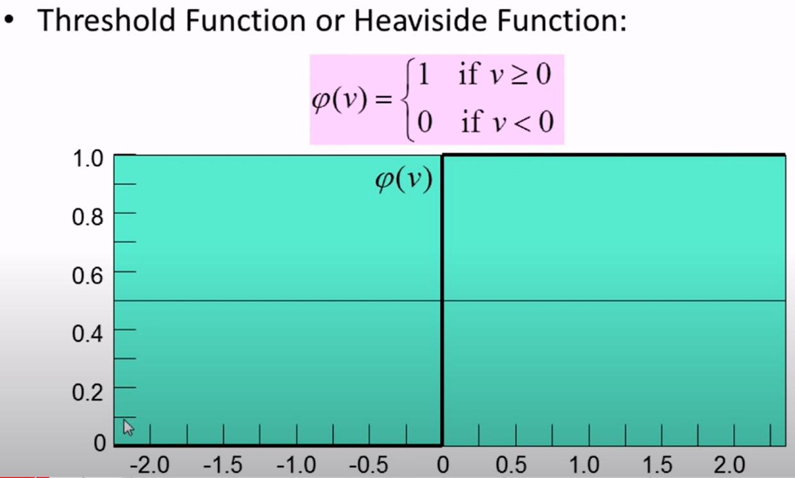
The Perceptron Cont’d Types of Activation Function

Slide 7
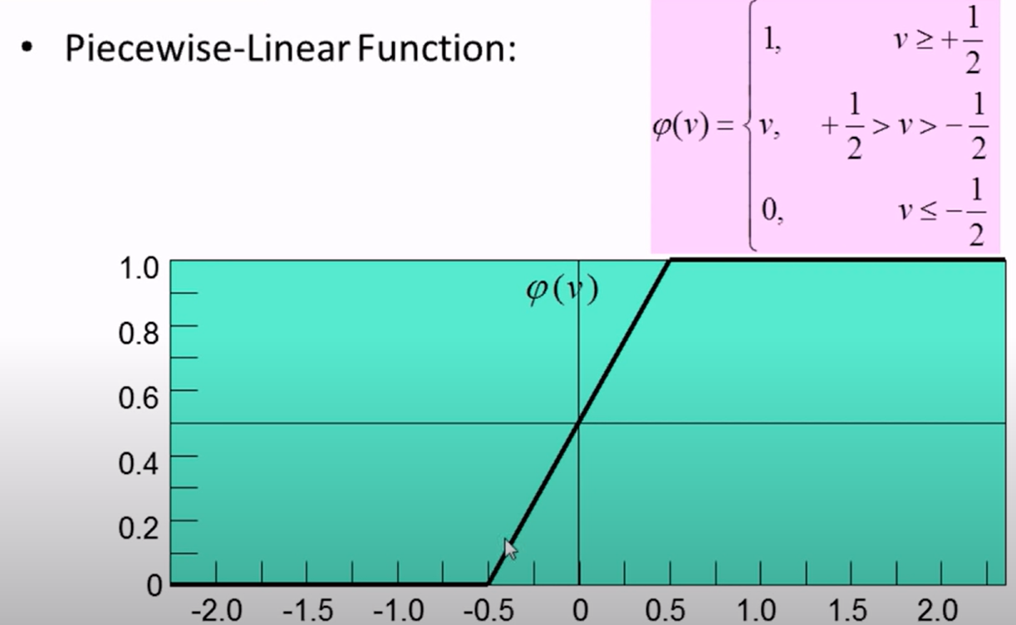
The Perceptron Cont’d Types of Activation Function

Slide 8
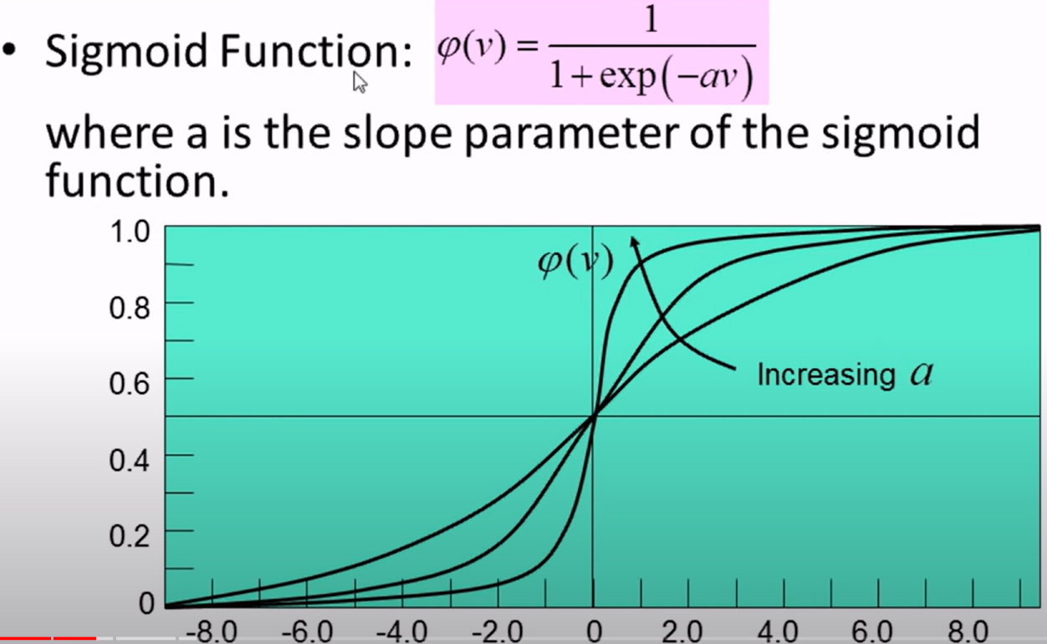
The Perceptron Cont’d Types of Activation Function

Slide 9
Choosing The Right Activation Function
The basic rule of thumb is if you really don’t know what activation function to use, then simply use RELU as it is a general activation function and is used in most cases these days.
If your output is for binary classification then, the sigmoid function is a very natural choice for the output layer.

Slide 10
Types of Perceptron
Single layer - Single layer perceptrons can learn only linearly separable patterns
Multilayer - Multilayer perceptrons or feedforward neural networks with two or more layers have greater processing power.
The Perceptron algorithm learns the weights for the input signals in order to draw a linear decision boundary.
This enables you to distinguish between the two linearly separable classes +1 and -1.

Slide 11
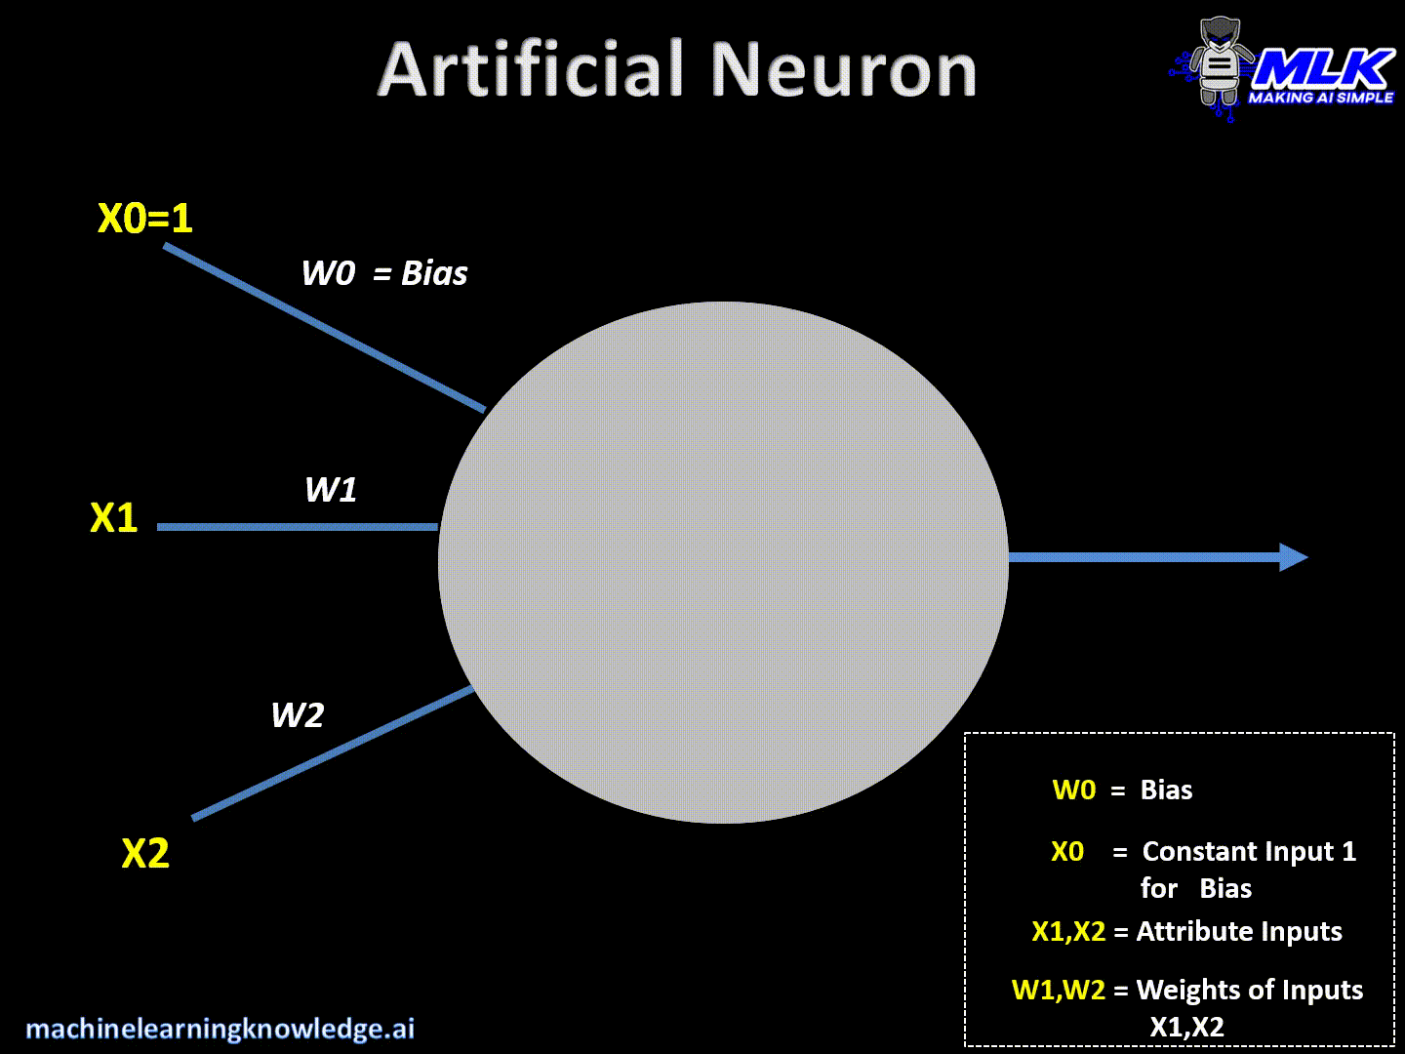

Slide 12
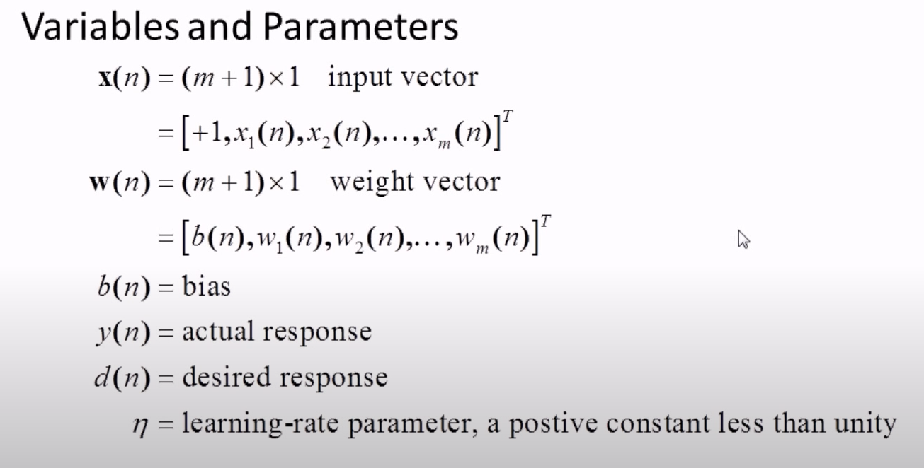
Perceptron Convergence (Learning ) Algorithm

Slide 13
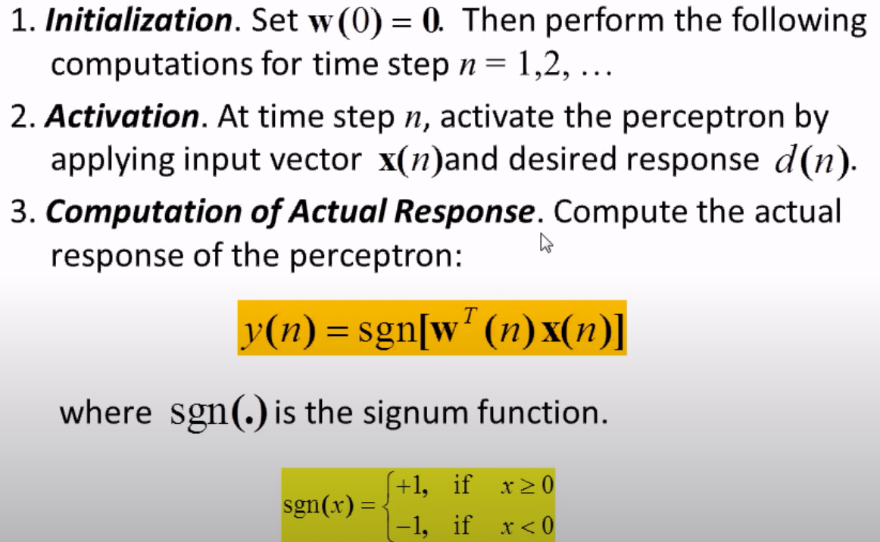
Perceptron Convergence (Learning ) Algorithm

Slide 14
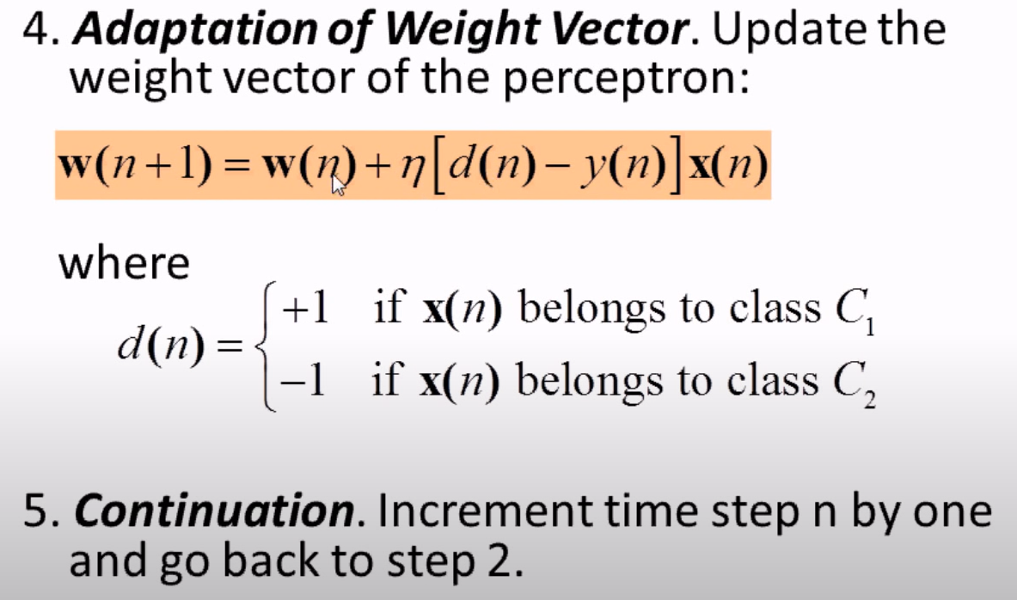
Perceptron Convergence (Learning ) Algorithm

Slide 15
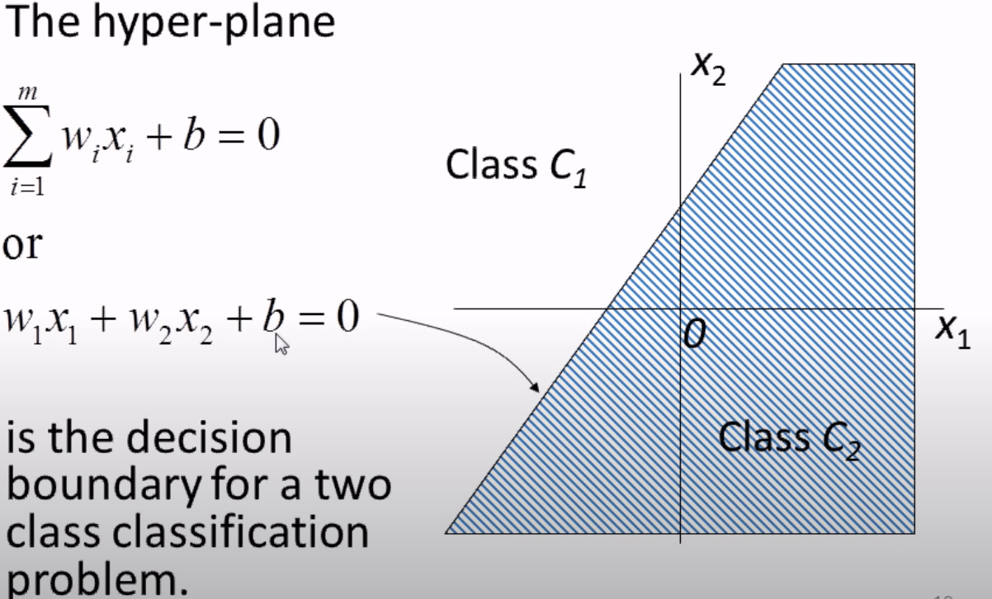
Decision Boundary
The decision boundary is always orthogonal to the weight vector.
Single-layer perceptron can only classify linearly separable vectors.

Slide 16
Decision Boundary
A perceptron (threshold unit) can learn anything that it can represent (i.e. anything separable with a hyperplane)

Slide 17
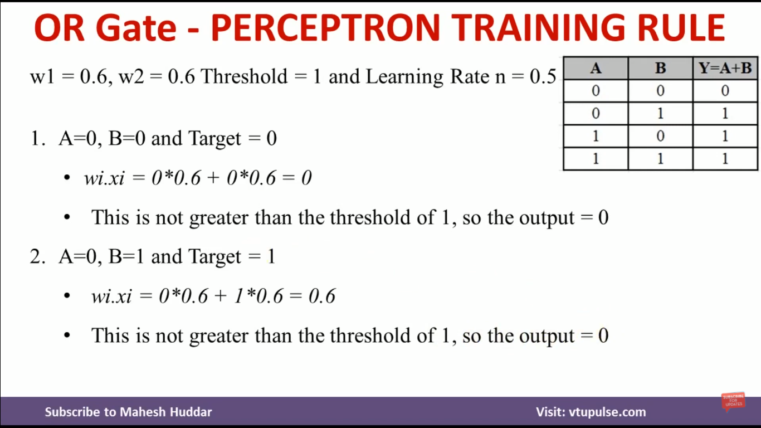
OR GATE Perceptron Training Rule

Slide 18
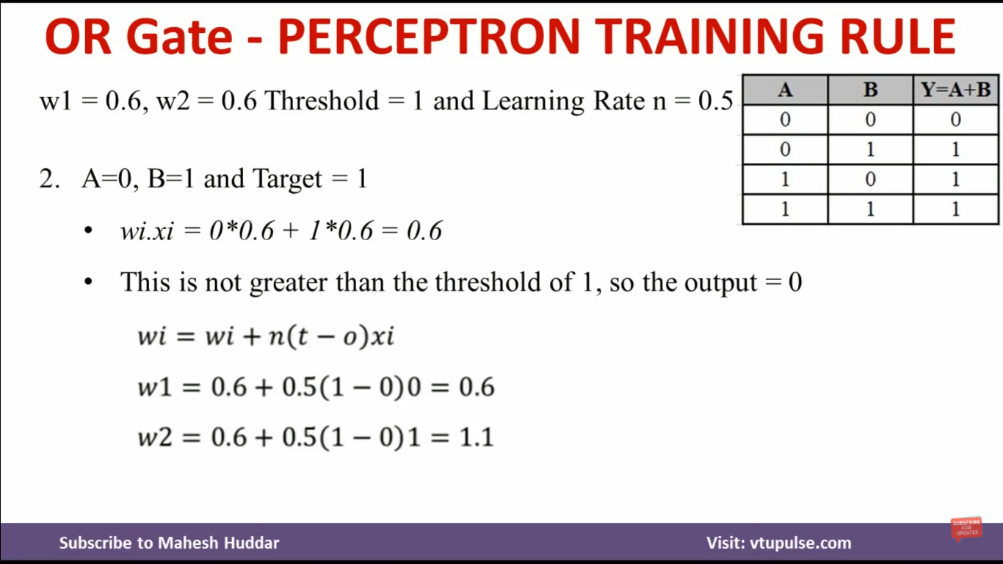
OR GATE Perceptron Training Rule
Update the weights.

Slide 19
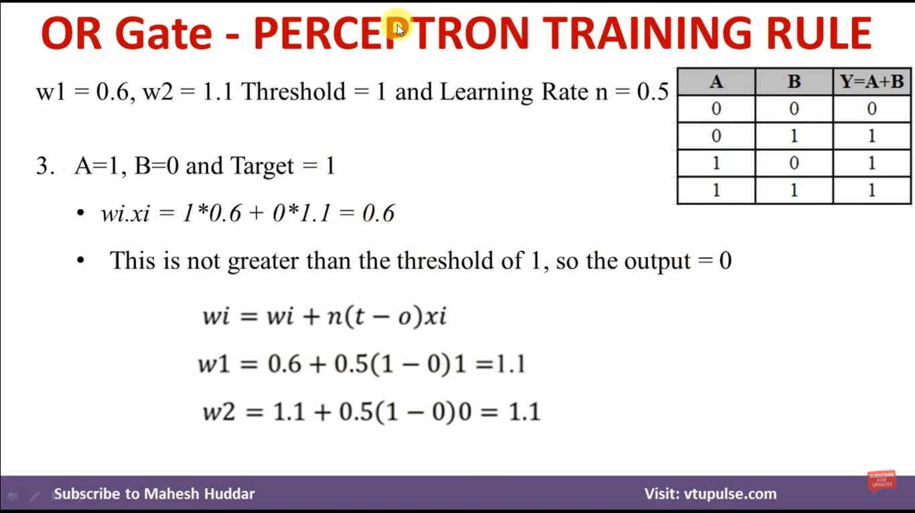
OR GATE Perceptron Training Rule
Update the weights.

Slide 20
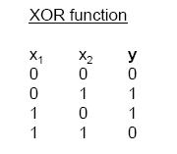
The Exclusive OR problem
A Perceptron cannot represent Exclusive OR since it is not linearly separable.

Slide 21
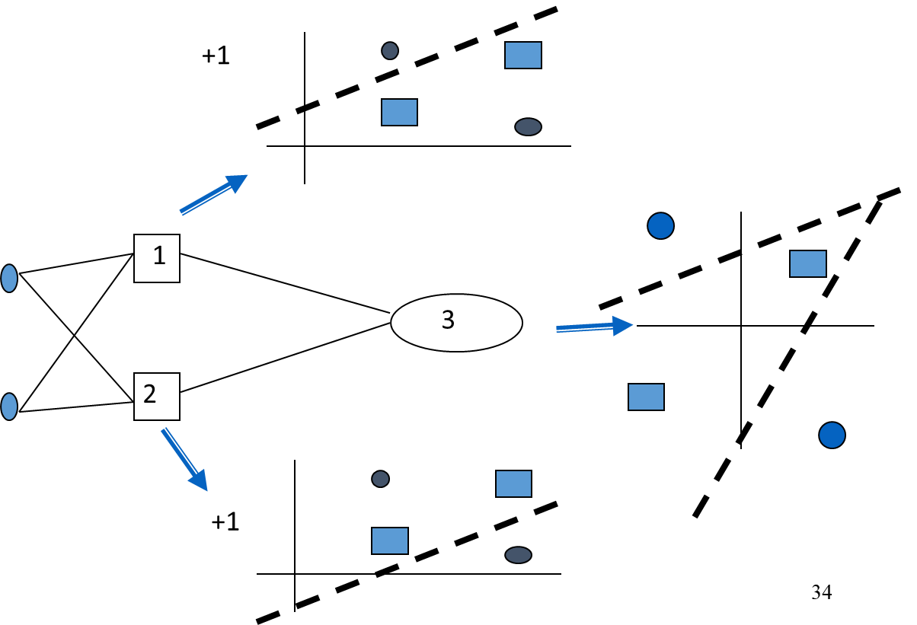
The Exclusive OR problem
Minsky & Papert (1969) offered solution to XOR problem by combining perceptron unit responses using a second layer of Units. Piecewise linear classification using an MLP with threshold (perceptron) units

Slide 22
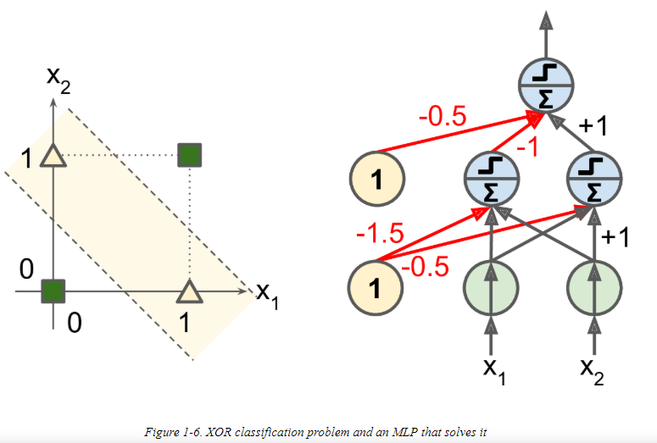
The Exclusive OR problem
In particular, an MLP can solve the XOR problem
For each combination of inputs: with inputs (0, 0) or (1, 1) the network outputs 0, and with inputs (0, 1) or (1, 0) it outputs 1.

Slide 23
Multi-Layer Perceptron and Its Properties
An MLP is composed of one (pass through) input layer, one or more layers of LTUs, called hidden layers, and one final layer of LTUs called the output layer (0ften more than 3 layers).
Every layer except the output layer includes a bias neuron is fully connected to the next layer
No connections within a layer
No direct connections between input and output layers
When an ANN has two or more hidden layers, it is called a deep neural network (DNN)

Slide 24
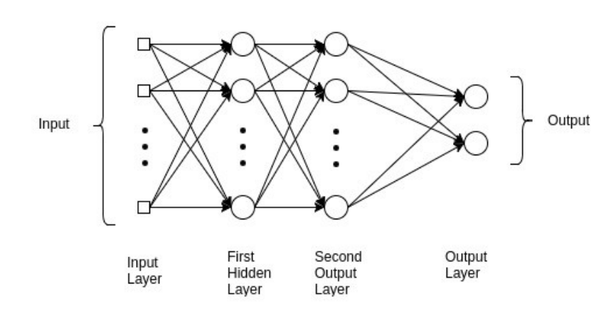
Multi-Layer Perceptron and Its Properties
The MLP is a feedforward neural network, which means that the data is transmitted from the input layer to the output layer in the forward direction.
The connections between the layers are assigned weights. The weight of a connection specifies its importance.
This concept is the backbone of an MLP’s learning process.

Slide 25
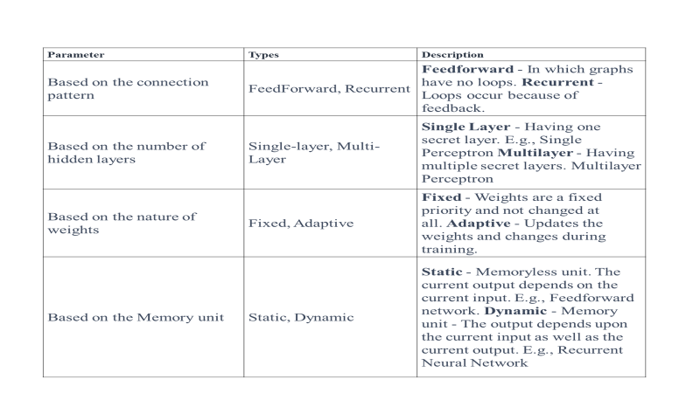
Summary

